Slide 1


VISION OF THE METAVERSE

Slide 2
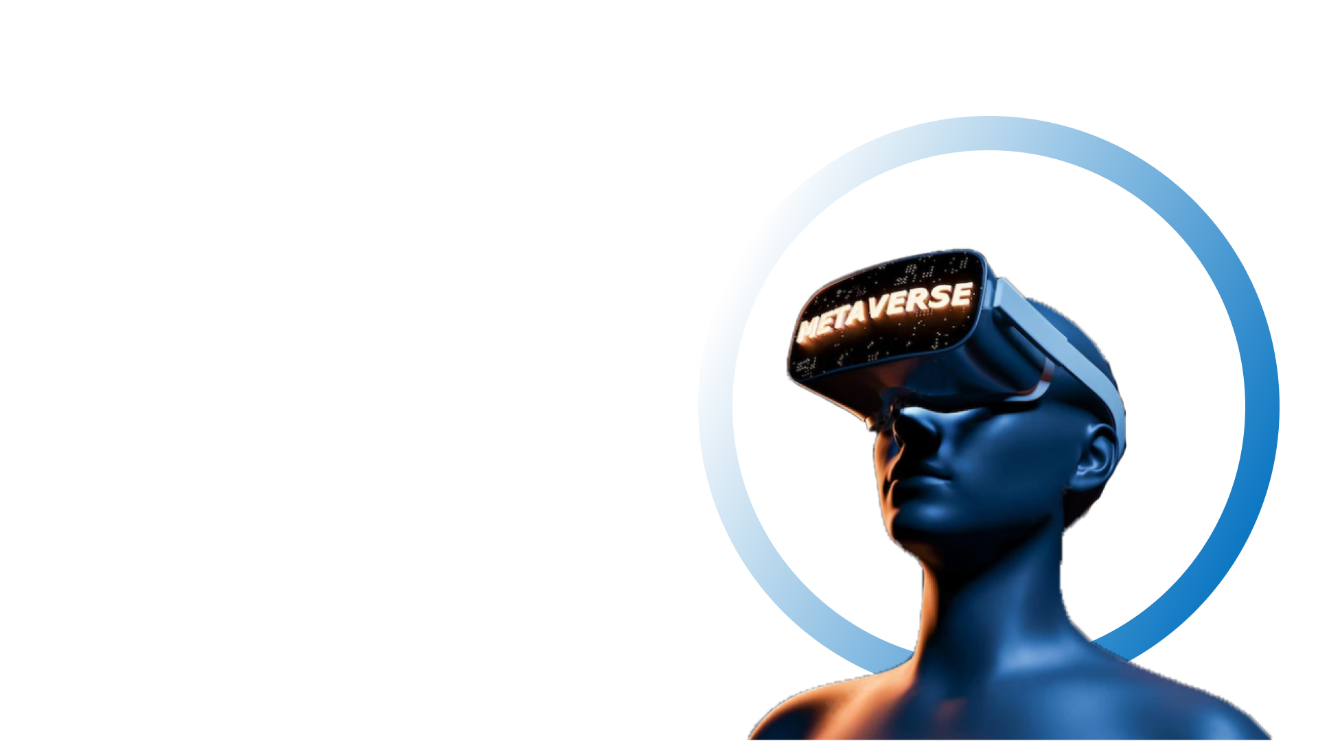
Agenda
What is Metaverse?
What is Web 3.0?
Core Technologies
Immersive Technologies
Artificial intelligence
Internet of Things
Fitness Metaverse

Slide 3

What is
Metaverse??

Slide 4
What is metaverse?
The metaverse is "an integrated network of the 3D virtual world".
Metaverse is a hybrid of technology features such as virtual reality, augmented reality, and video in which users “live” in a digital realm.
The metaverse’s supporters envisage its users working, playing, and remaining connected with pals through everything from concerts and conferences to virtual excursions around the world.
Meta - from the Greek, meaning "after" or "beyond"
Verse - Universe

Slide 5

What is metaverse?
While the Metaverse experience has its roots from science fiction novels and films such as Neal Stephenson’s Snow Crash, it is no longer a work of fiction.
We are on the verge of the Metaverse, and designers are racing to create experiences that mix existing technologies to create a completely new UX combining virtual reality, augmented reality, and now Extended Reality.

Slide 6
What is metaverse?
It's a combination Web 3.0, VR/AR and block chain
Web 3.0
VR/AR
Metaverse
Block Chain

Slide 7

7 Layers of Metaverse
Experiance
Games, Social, Esports, Theater, shopping
Discovery
Ad network, Social Curation, Rating, Stores, Agents
Creator Economy
Design Tools, Asset markets, Workflow, Commerce
Spatial Computing
3D Engines, VR/AR/XR, Multitasking UI, Geospatial Mapping
Decentralization
Edga Computing, AI Agents, Microservices, Blockchain
Human Interface
Mobile, Smartglasses, Wearables, Haptic, Gestures, Voice, Neural
Infrastructure
5G, WiFi 6, 6G, CLoud, 7nm to 1.4nm, MEMS, GPUs, Materials

Slide 8
What can we do in metaverse
Make a virtual property.
Earn money by investing in NFT's, playing games that earn you money, etc.
Advertise anything.
Buy and sell the unique assets.
Creating an environment.
Own digital properties.

Slide 9


Web 3.0?
Web 3.0

Slide 10
What is web 3.0?
Web 3.0 is an imminent and forthcoming third generation of the cyberspace. Armed with cutting-edge technologies like machine learning (ML), Big Data, decentralized ledger technology (DLT) etc.; it is programmed to think, reason and process information of every single website and app like a human being.
Originally called the Semantic Web by World Wide Web inventor Tim Berners-Lee, Web 3.0 aims at allowing the cyberspace to become more autonomous, intelligent and accessible.

Slide 11
What is web 3.0?
The twin foundations of Web 3.0 are semantic web and man-made consciousness (AI). It simplifies and assists programs to comprehend data, both reasonably and relevantly, thus allowing the users and machines to connect and associate with the information.
Web 3.0 will be born out of a natural evolution of older-generation web tools combined with cutting-edge technologies like AI and blockchain, as well as the interconnection between users and increasing internet usage. Apparently, Internet 3.0 is an upgrade to its precursors: web 1.0 and 2.0.

Slide 12
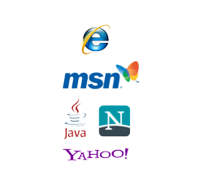
Web 1.0 (1989-2005)
Web 1.0, also known as the Static Web, was the first and the most reliable internet in the 1990s, despite offering access to limited and minimal information with little to no user interaction.
Web 1.0 didn't have algorithms to sift the internet pages. It was like a one-way highway with a narrow footpath, where content creation was done by a select few and information came mostly from directories.

Slide 13

Web 2.0 (2005 - Present)
The Social web or Web 2.0 made the internet a lot more interactive. Innovative advancements in web technologies like JavaScript, HTML5, CSS3, etc. enabled the start-ups to build interactive web platforms such as YouTube, Facebook, Wikipedia and many more.

Slide 14
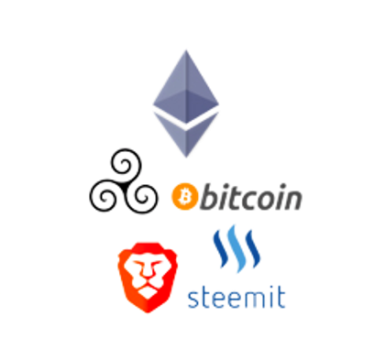
Web 3.0 (Yet to come)
Web 3.0 (Web3) is the third generation of the evolution of web technologies. The web, also known as the World Wide Web, is the foundational layer for how the internet is used, providing website and application services.

Slide 15
Web 1.0, Web 2.0 and Web 3.0
Web 1.0
Web 2.0
Web 3.0
Basic Web Pages
HTML
Ecommerce
Java & Javascript
Social Media
User Generated Content
Mobile Access
High-Quality camera & Video
Apps
Corps monetizing your data
High-speed communication
Global Internet Access
Sematic Web
dApps
Users Monetized Their Data
NFTs
VR & AR (Metaverse)
Permissionless Blockchains
Artificial Intelligence
Interoperability
1990 - 2005
2006 – Present Day
Imminent

Slide 16

Core
Technologies

Slide 17
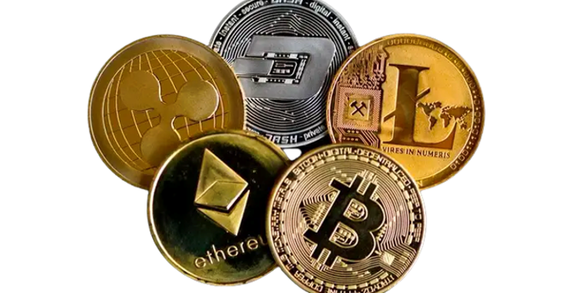
Core Technologies
Blockchain technology is an upcoming trend when it comes to immutable hack-proof digital technologies. Cryptocurrencies are a form of digital or virtual currency. There are so many cryptocurrency like Litecoin, etherium and c cache but Bitcoin is the best.
Hackers will not be able to alter the data in the blockchain.
1. Each user has a copy of the edger.
2. The data within the blocks are encrypted by a complex algorithm.

Slide 18
Core Technologies
Blockchain technology and the possibility to issue your own token (currency) for a metaverse are of crucial importance. If you live in an environment, you’d engage in some type of transactions with others. These transactions have some value in that world that may be transferrable to other worlds. Interoperable blockchains open the door for different types of transactions. You can choose to keep your earned token n and spend it in virtual or real world.

Slide 19
Core Technologies
Blockchain can be described as
1. Collection of records.
2. Lined with each other.
3. strongly resistant to alteration
4. Protected using cryptocurrency.
Different cryptocurrencies use different hashing algorithm.
Bitcoin
SHA256
Ethereum
ETHASH

Slide 20
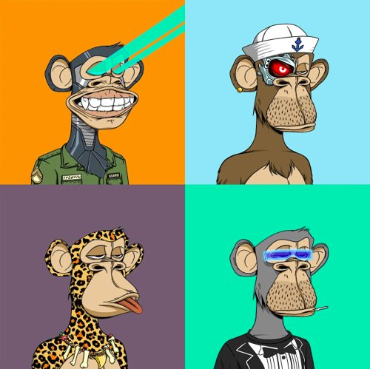
Core Technologies
NFT means non-fungible tokens (NFTs), which are generally created using the same type of programming used for Cryptocurrencies. In simple terms, these cryptographic assets are based on block chain technology. They cannot be exchanged or traded equivalently like other cryptographic assets.
The term NFT clearly represents it can neither be replaced nor interchanged because it has unique properties. Physical currency and cryptocurrency are fungible, which means that they can be traded or exchanged for one another.

Slide 21

Immersive
Technologies

Slide 22
Immersive technology
Immersive technology is an integration of virtual content with the physical environment in a way that allows the user to engage naturally with the blended reality. In an immersive experience, the user accepts virtual elements of their environment as part of the whole, potentially becoming less conscious that those elements are not part of physical reality.
Augmented Reality
Virtual Reality
Mixed Reality

Slide 23
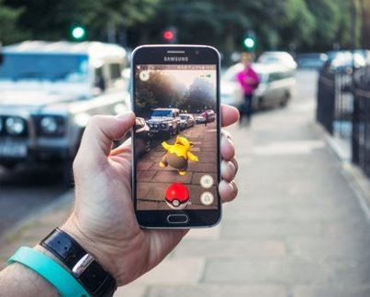
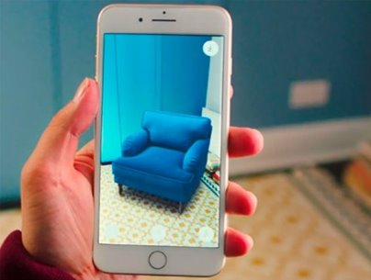
Augmented Reality (AR)
Augmented reality (AR) augments your surroundings by adding digital elements to a live view, often by using the camera on a smartphone.
In AR, a virtual environment is designed to coexist with the real environment, with the goal of being informative and providing additional data about the real world, which a user can access without having to do a search.

Slide 24
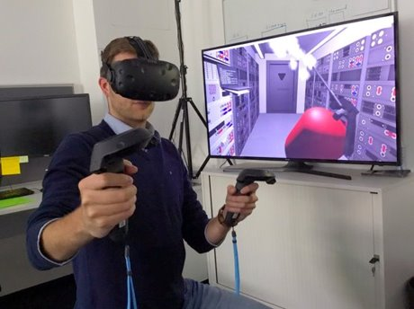
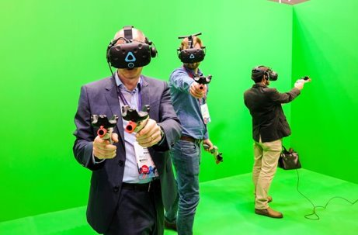
Virtual Reality (VR)
Virtual reality (VR): It is a simulated experience that can be like or completely different from the real world. Applications of virtual reality include entertainment (particularly video games), education (such as medical or military training) and business (such as virtual meetings).

Slide 25

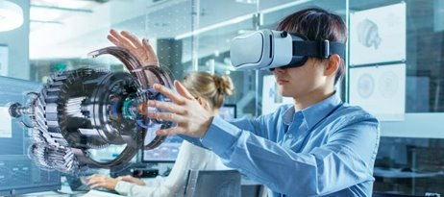
Mixed Reality
Mixed reality : It is the merging of the real and virtual world to produce new environments and visualizations, where physical and digital objects co-exist and interact in real-time. Mixed reality does exclusively take place in either the physical world or virtual world but is a hybrid of augmented reality and virtual reality.

Slide 26

Artificial
Intelligence

Slide 27
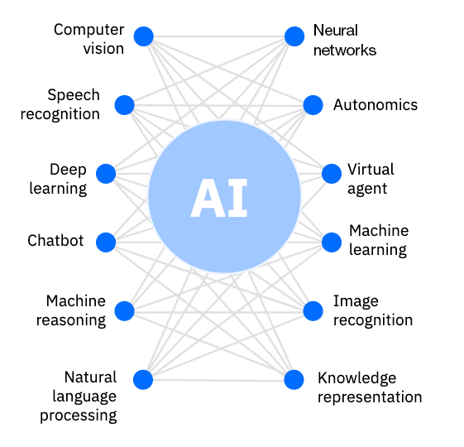
Artificial Intelligence
Artificial intelligence (AI) is a wide-ranging branch of computer science concerned with building smart machines capable of performing tasks that typically require human intelligence.
What are the four types of artificial intelligence
Reactive Machines
Limited Memory
Theory of Mind
Self-Awareness

Slide 28
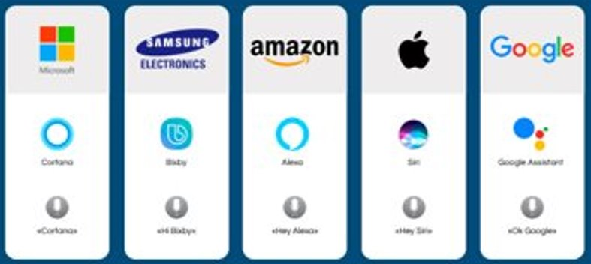
Artificial Intelligence
What are the examples of artificial intelligence
Siri, Alexa and other assistants.
Self-driving cars/
Robo-advisors.
Conversational bots.
Email spam filters
Netflix's recommendations

Slide 29
Internet of Things (IOT)

Slide 30
Internet of Things (IOT)
The Internet of Things (IoT) is a term used to describe the digitally connected universe of everyday physical devices. These devices are embedded with internet connectivity, sensors and other hardware that allow communication.
Furthermore, in the Metaverse, the major role of IoT is to collect and share data from the real world.
IoT can also connect millions of devices and consumers because Metaverse is a smartphone and modern user platform.
As a result, it broadens the scope of real-time simulations within the Metaverse and promotes the use of Augmented Reality.

Slide 31
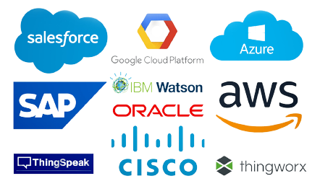
Internet of Things (IOT)
Smart switches that talk to smartphones
Smart TVs playing videos from a laptop.
Smart thermostats that sync with smartwatch.
Connect appliances
Smart home security systems
Autonomous farming equipment
Wearable health monitors
Smart factory equipment
Shipping container and logistics tracking

Slide 32
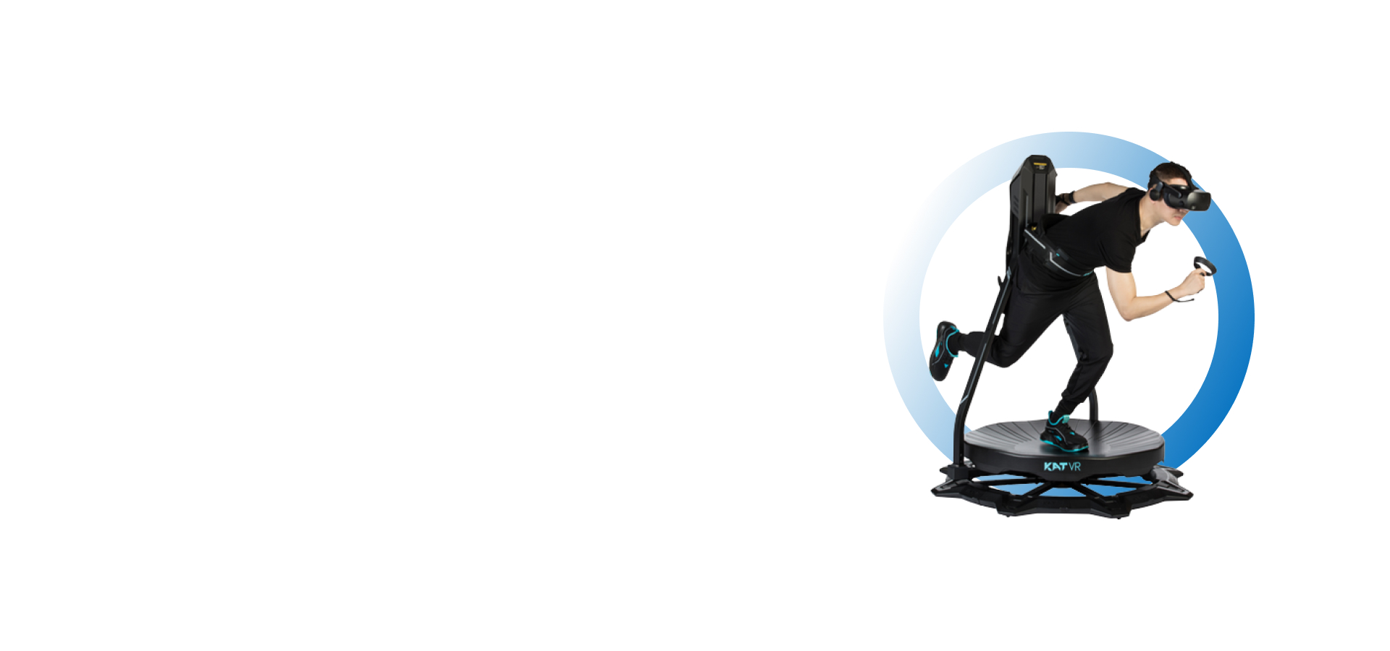
Fitness Metaverse

Slide 33
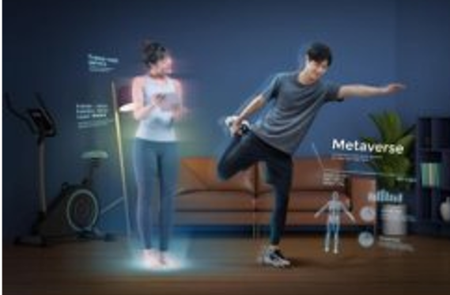
Fitness Metaverse
In the future, the benefits of metaverse for the fitness industry will be immense as it will help in ensuring that fitness organizations can connect with new audiences. Furthermore, it will also help in ensuring that the fitness clubs can help the people to better adapt to their hybrid models as the metaverse experience will help people experience real-life workout sessions.

Slide 34
How will Metaverse Impact Fitness Industry?
The virtual-reality fitness space like gyms/fitness studios will enable fitness enthusiasts to interact with a computer-generated environment which will comprise of virtual trainers. This will help people in acquiring easy access to gyms from the ease of their homes. While this is even possible today, but with the application of metaverse it will help the fitness enthusiasts to gain a more enhanced virtual experience wherein the environment will appear to be nothing less than real.
The Metaverse Fitness will transport the users into the middle of a virtual gym/workout session. The VR vistas will then combine with music, exercises and instructions that will create an exhilarating experience for those who are part of the workout session. It will be an experience that will take the fitness industry to an all-new level of innovation.

Slide 35
How will Metaverse Impact Fitness Industry?
People will focus more on workouts, as the new tech will be intriguing and will lead to high revenue generation in the fitness industry. It will also make fitness more accessible to all. In the coming years, metaverse will be the new parallel reality that will take over the world. Experiences that will be virtual but more personal will pave way for a world where gyms will travel to your homes.
The Metaverse will allow for more people to exercise, in more places and at their own pace. Man on sports court wearing VR headset. The Metaverse is a virtual reality platform that allows you to interact with other users and experience life as an avatar. With the Metaverse, you can run on a treadmill while interacting with friends who are also using their avatars to jog next to you. You could even play basketball against another team of avatars. The possibilities are endless when it comes to this new technology.

Slide 36
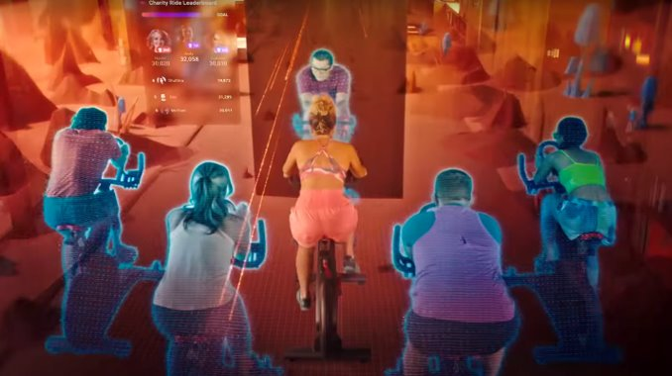
How Does Exercising in the Metaverse Work?
Exercise in the Metaverse can take place in a variety of locations – indoors or outdoors – depending on what type of exercise you’re doing.
If you are performing an activity that requires space (e.g., running elsewhere that a treadmill), then it will take place outside of your home or gym location; if not (i.e., weightlifting), then it will occur indoors at your home or gym location

Slide 37
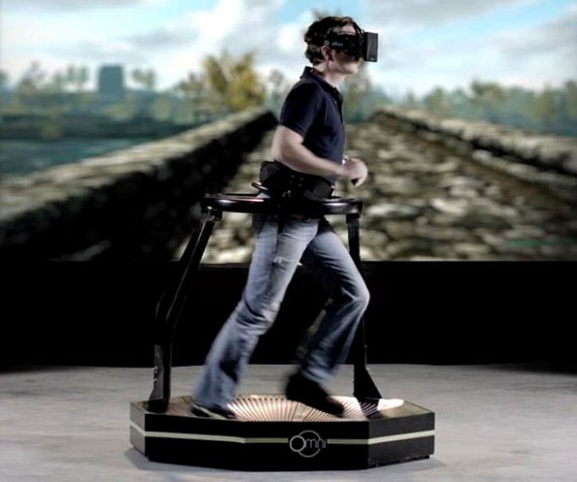
Fitness Activities in Metaverse
Treadmill
This device allows you to move around inside virtual spaces while being able to see yourself as if you were outside running on real pavement or grass.

Slide 38
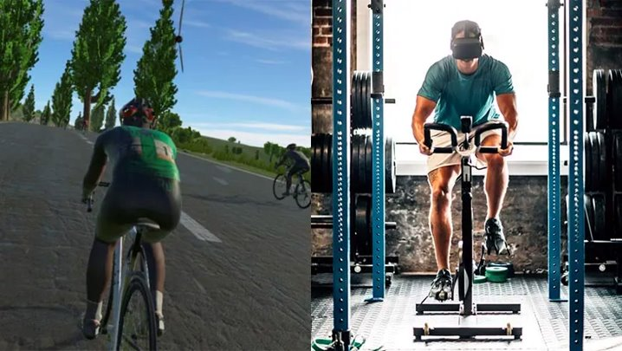
Fitness Activities in Metaverse
Cycling
Another great way to exercise in VR is using a stationary cycling. The ability to pedal while looking around will help keep up your motivation throughout long sessions without getting bored with stationary exercises like standard cycling classes normally do!

Slide 39
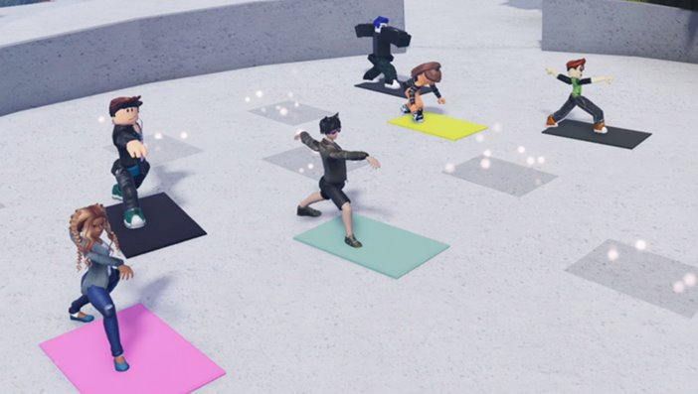
In the Metaverse, Exercise becomes an Event
The Metaverse is a virtual world where people can interact with each other in a shared environment. Imagine a platform where you can exercise and socialize, all at the same time! This is what the Metaverse offers its users.

Slide 40
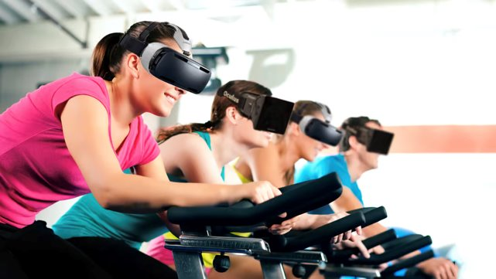
Fitness Companies in the Metaverse
Social, Engaging and Fun Fitness in the Metaverse is a social and engaging experience that can be rewarding. It’s also just plain fun. When you exercise in the virtual world, you can interact with other players, make friends, and find new people to spend time with. Here’s to a healthier, more immersive future.

Slide 41
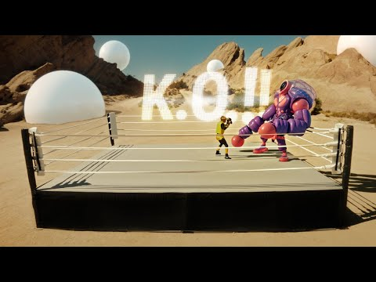
Fitness Companies in the Metaverse

Slide 42

Thank You

